Slide 1

Directions:
For this planning tool insert text boxes to type or write in the boxes. Duplicate Create slides as needed for your work.
Be sure to pause during Evaluation stages and consult with another person about your ideas.

Slide 2


Slide 3
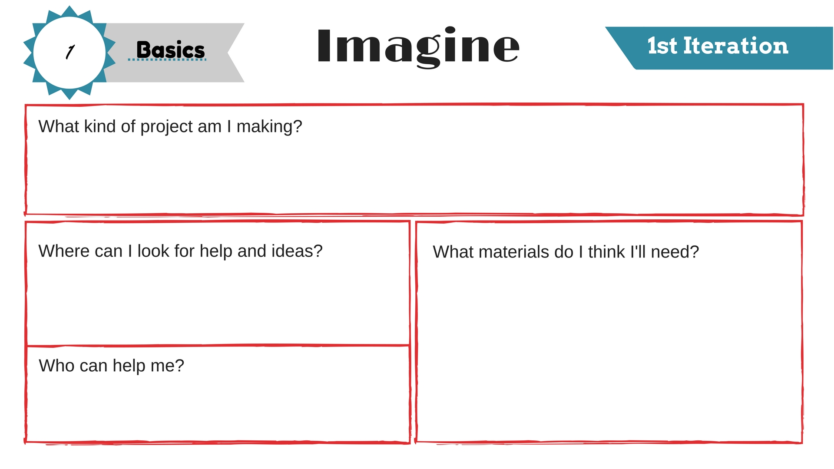

Slide 4
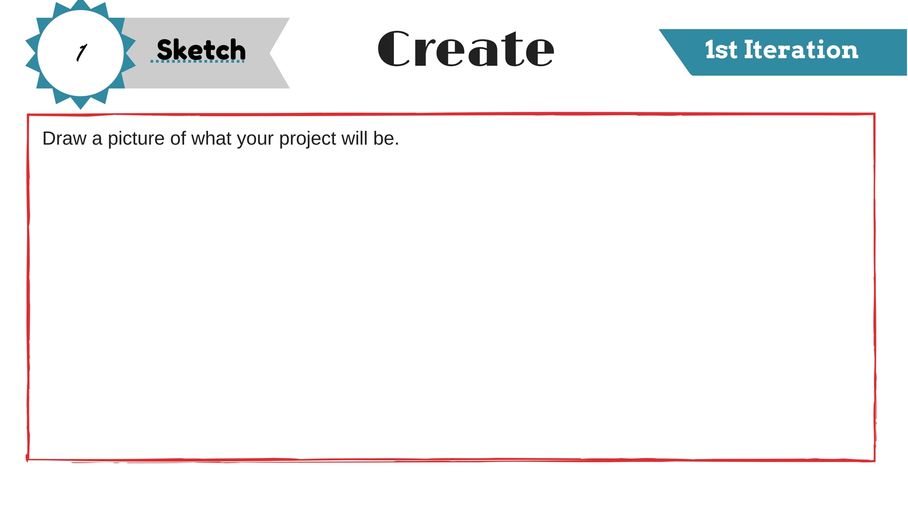
*Use this if you are building or drawing something

Slide 5
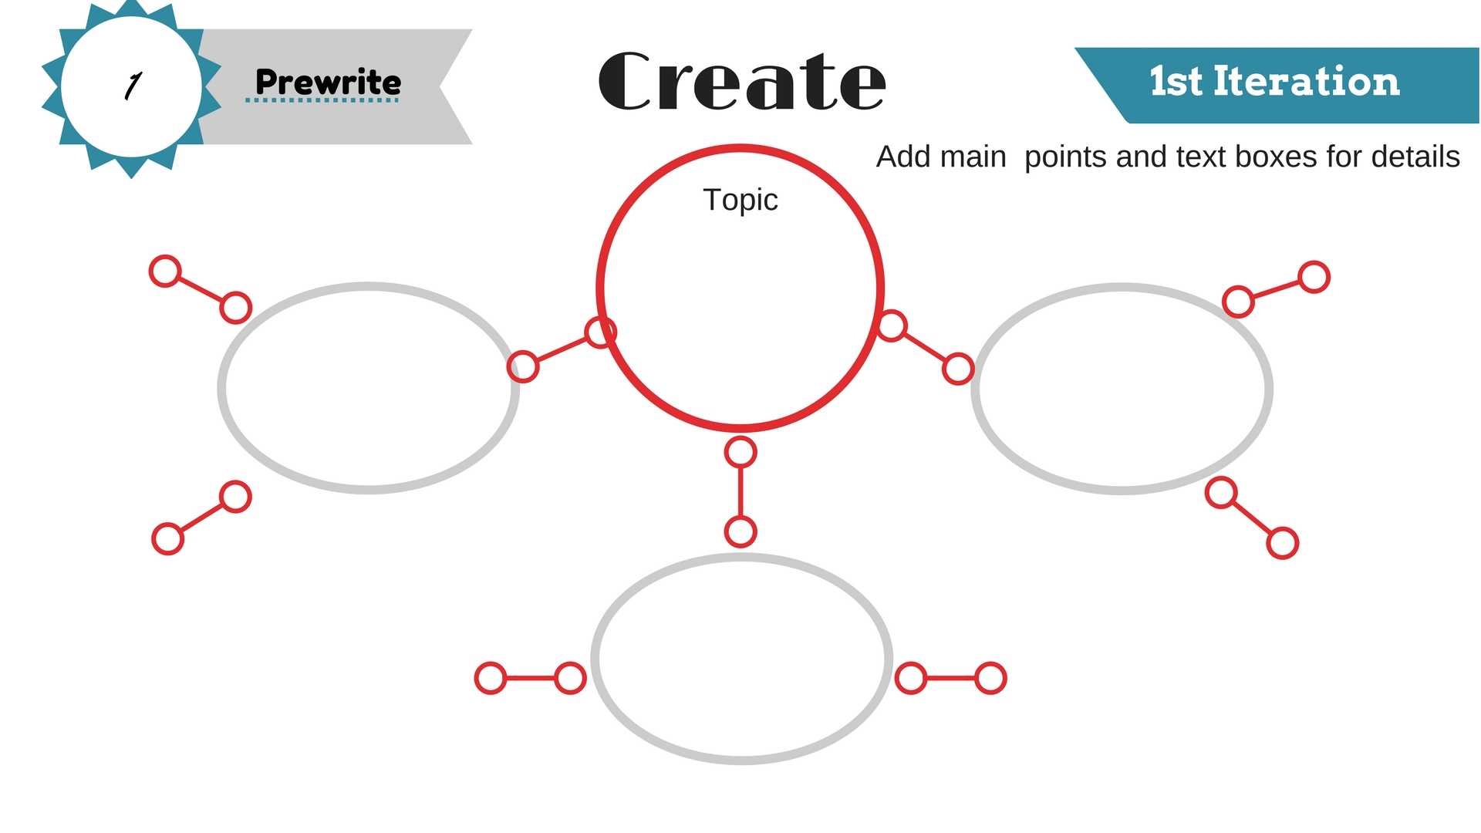
*Use this if you are doing a presentation or a multimedia project

Slide 6
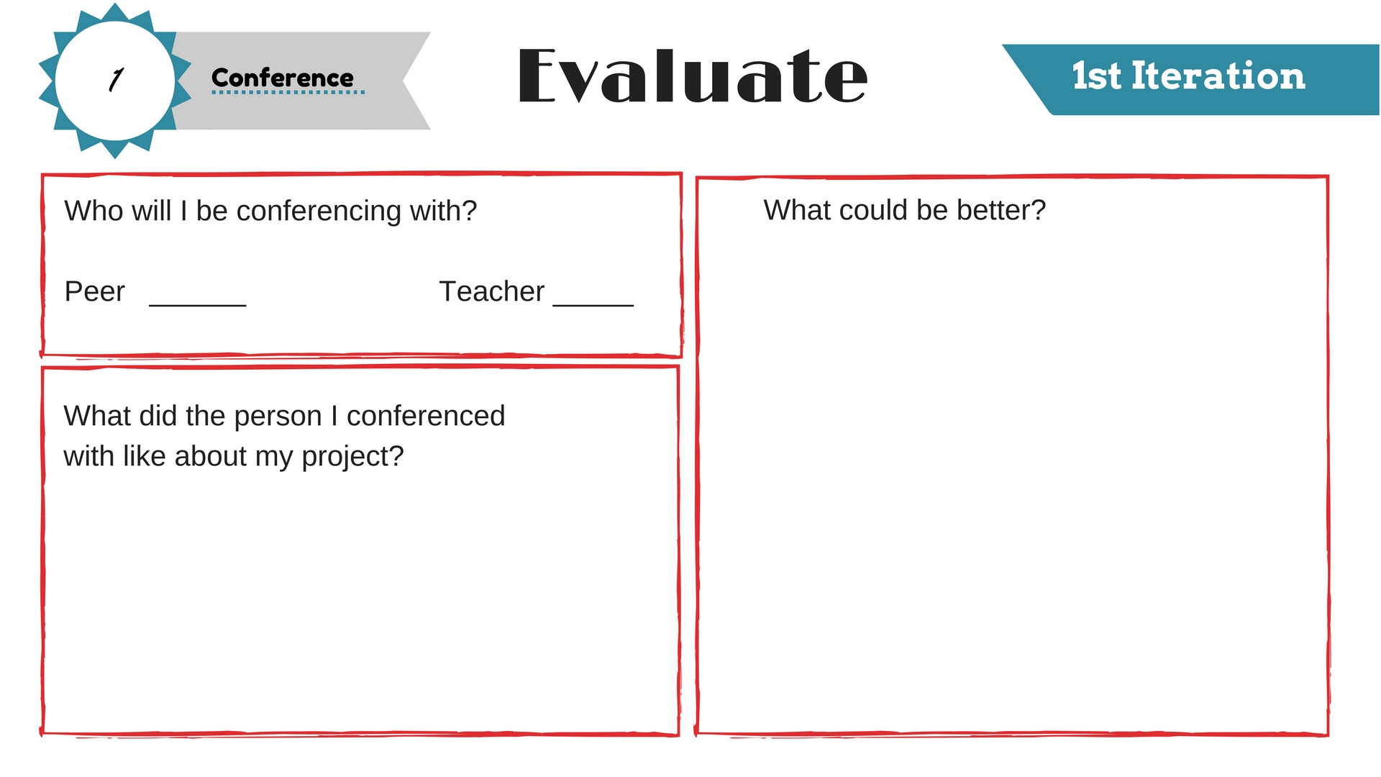

Slide 7


Slide 8
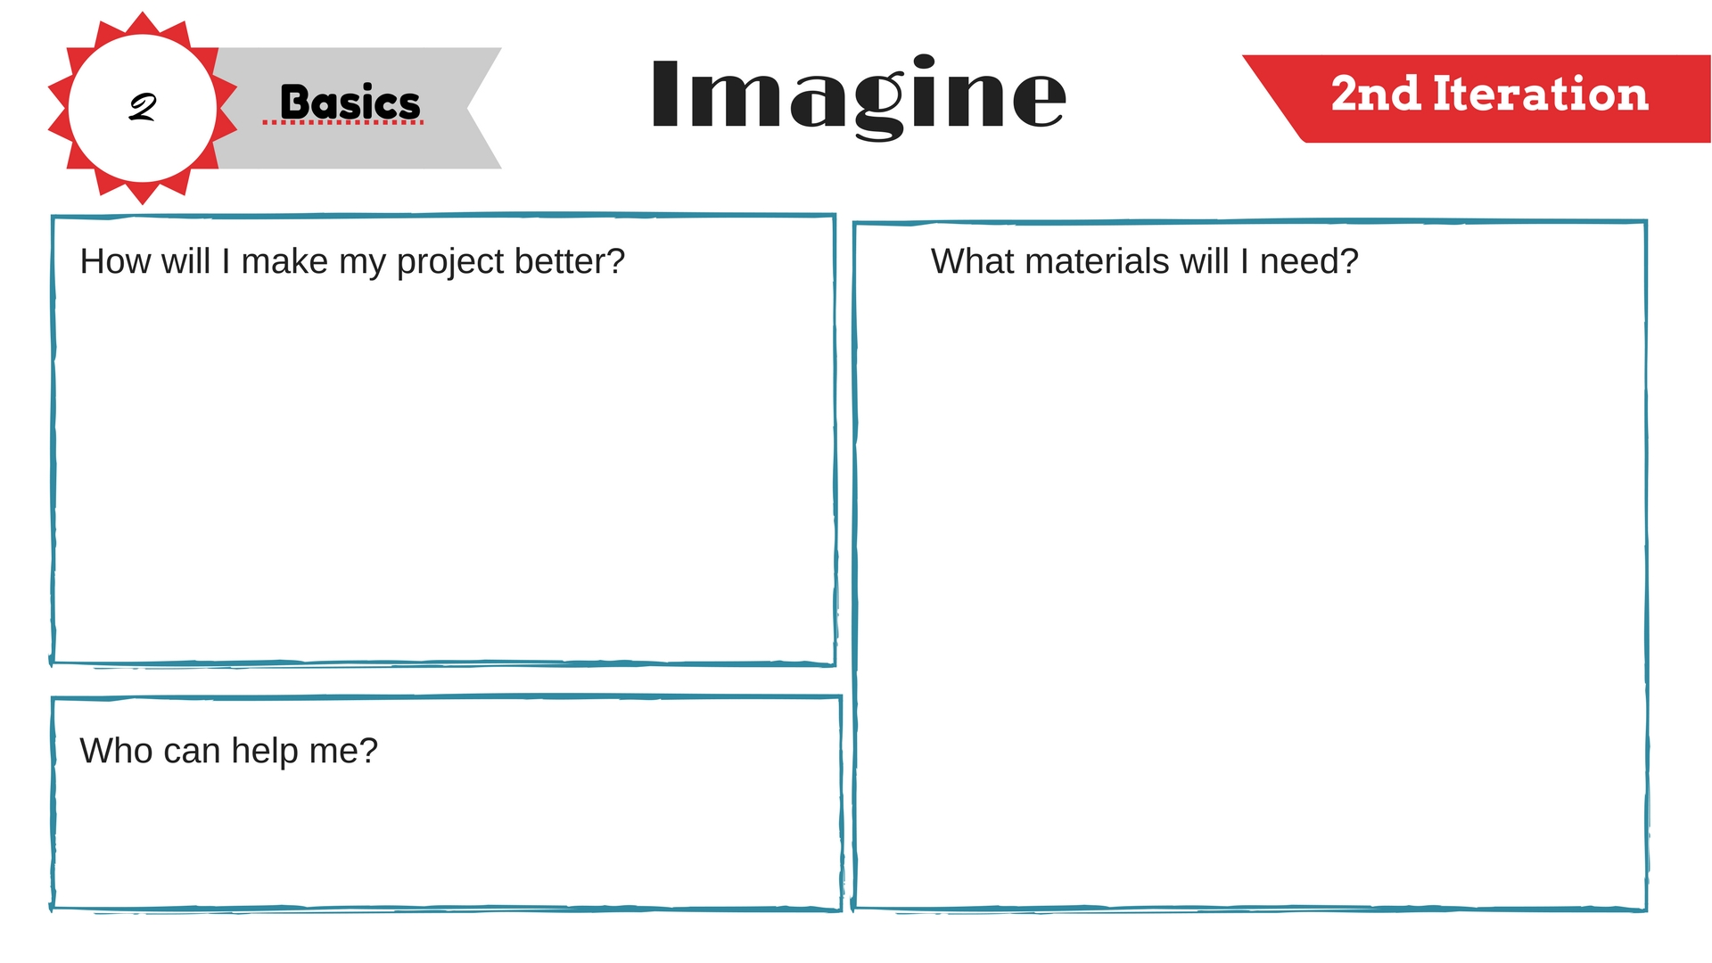

Slide 9
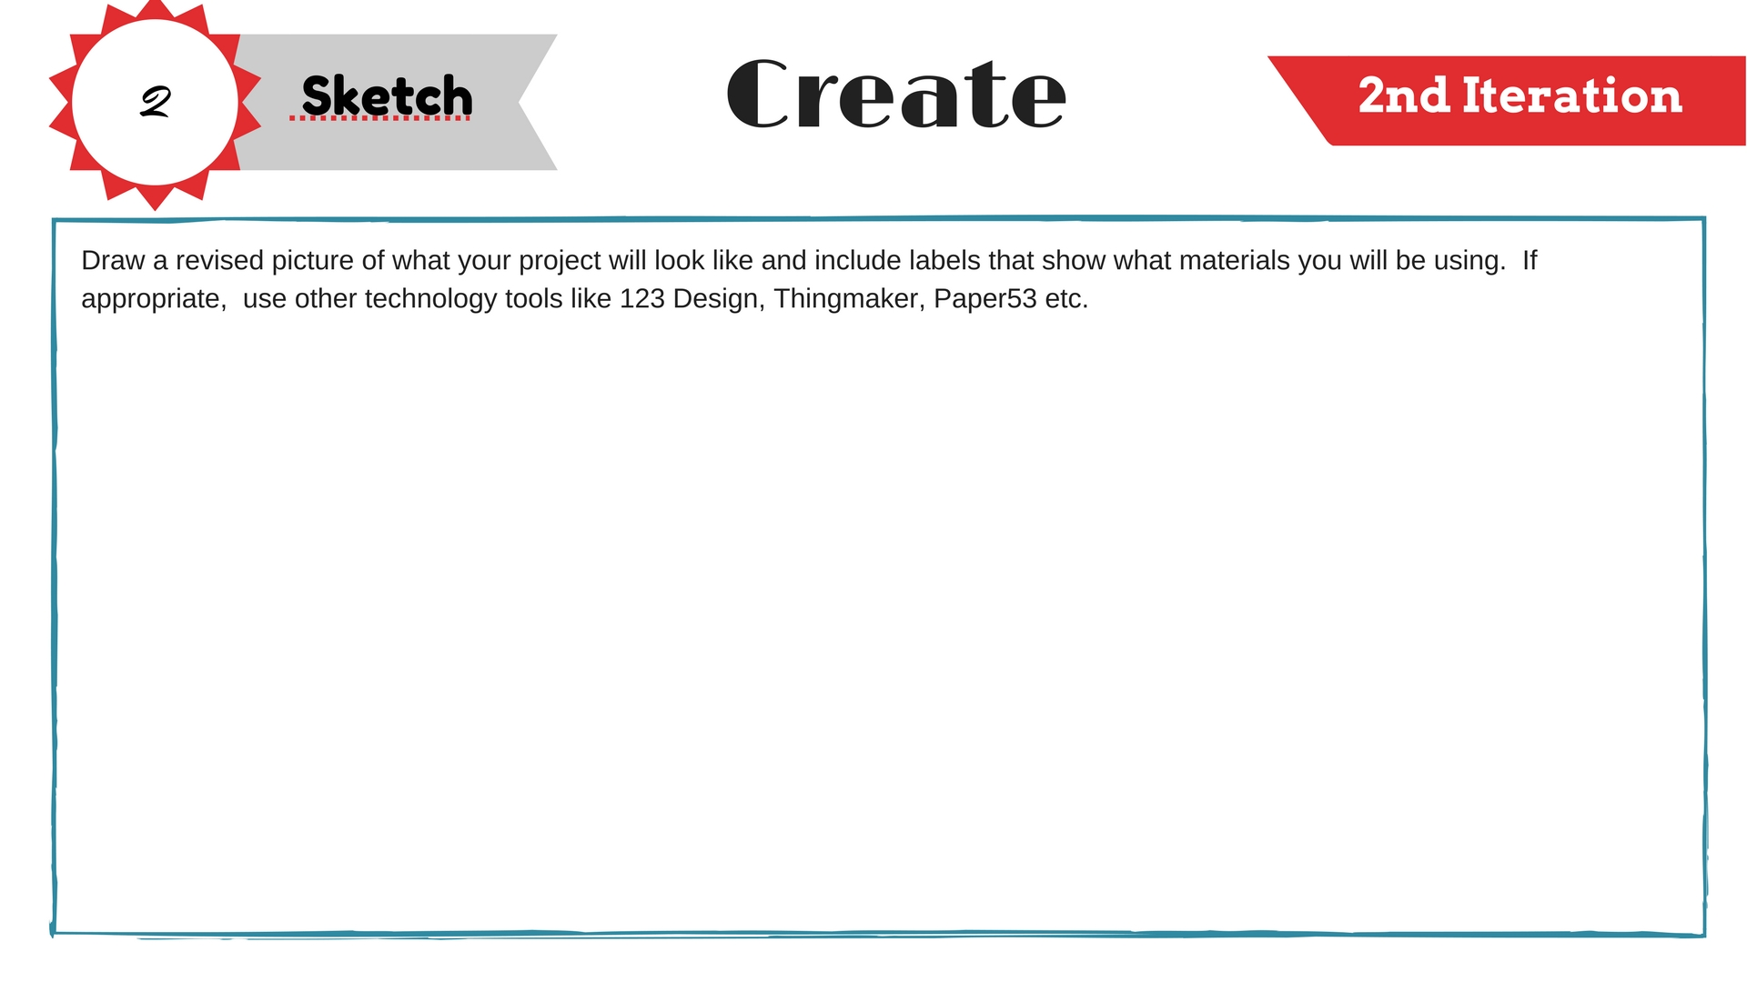
*Use this if you are building or drawing something

Slide 10
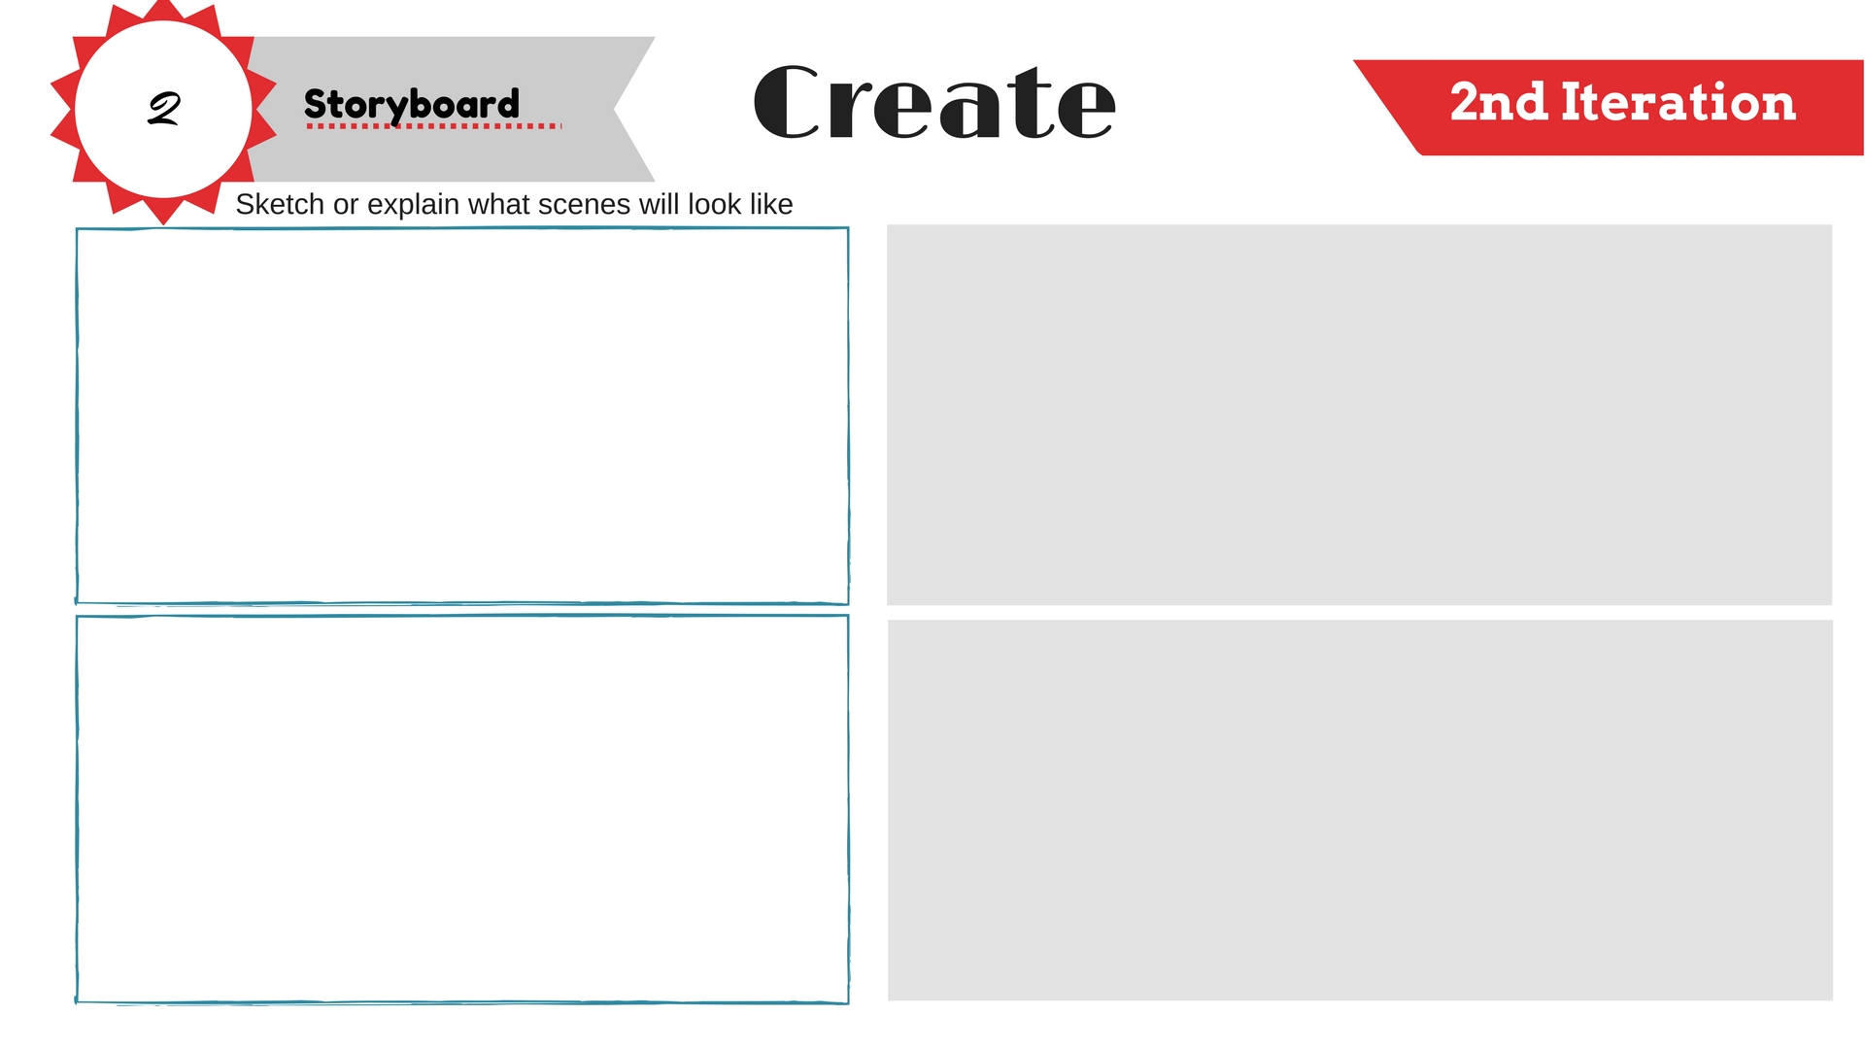
* Use this if you are presenting, doing a performance of some kind, or making a multimedia presentation

Slide 11
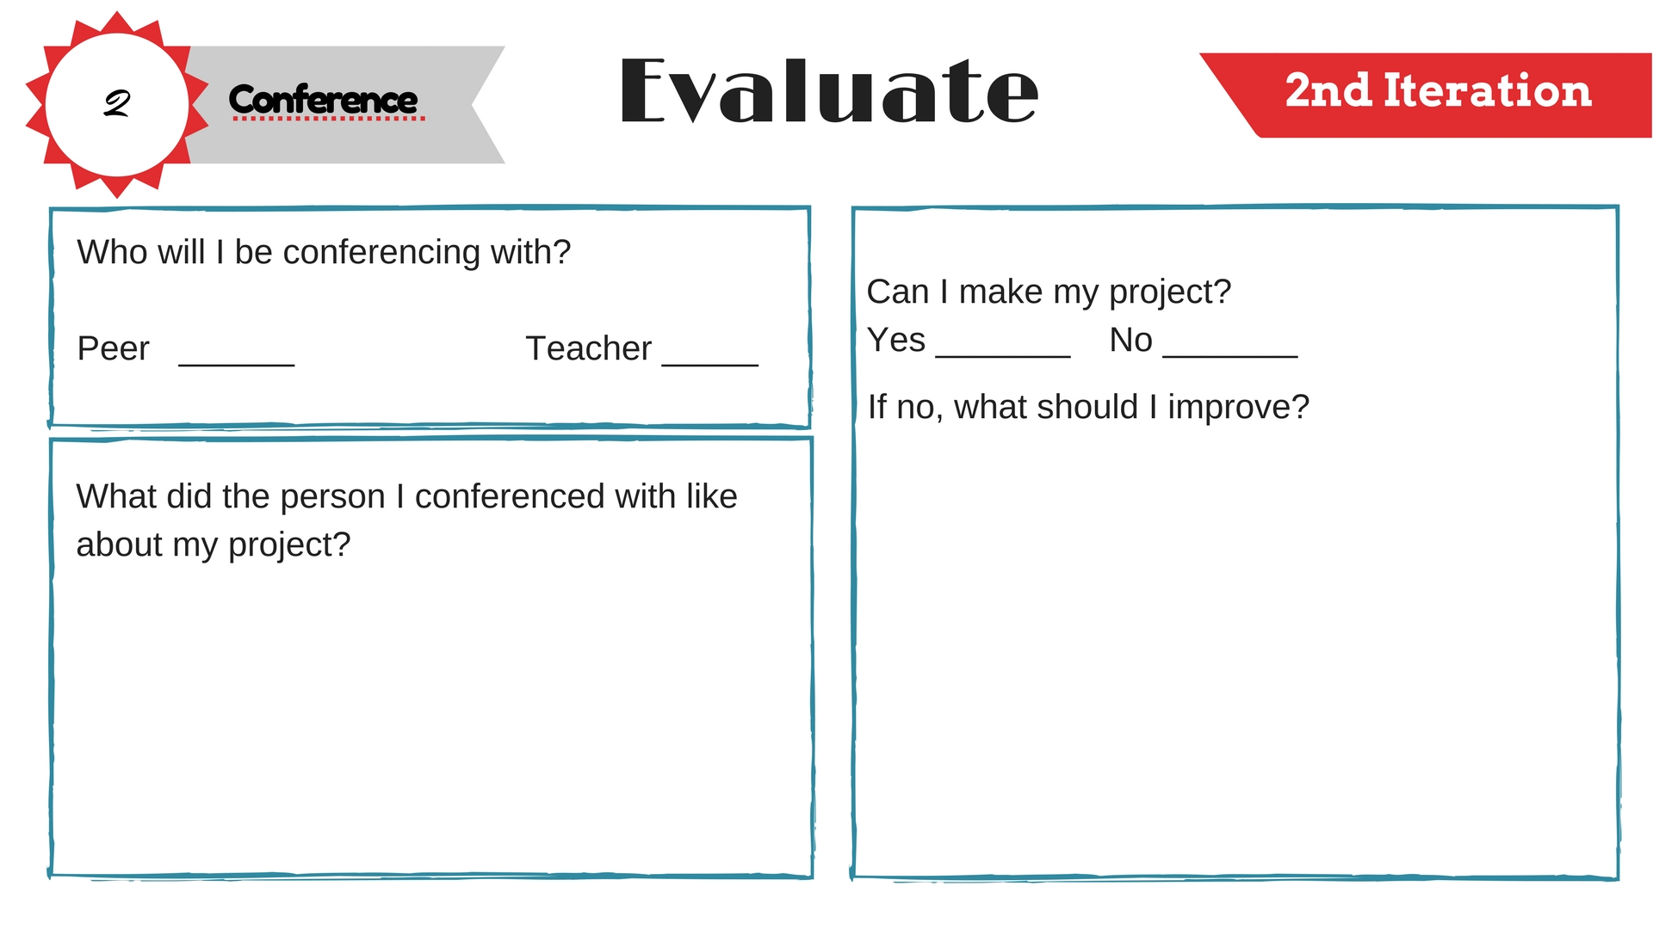

Slide 12


Slide 13
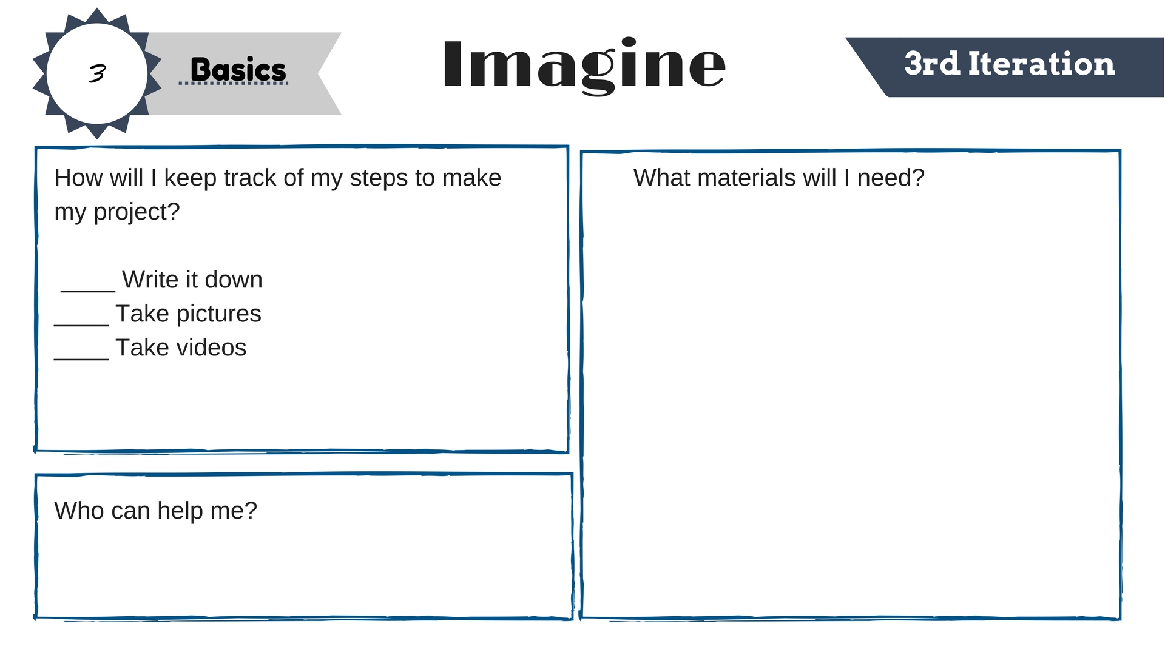

Slide 14
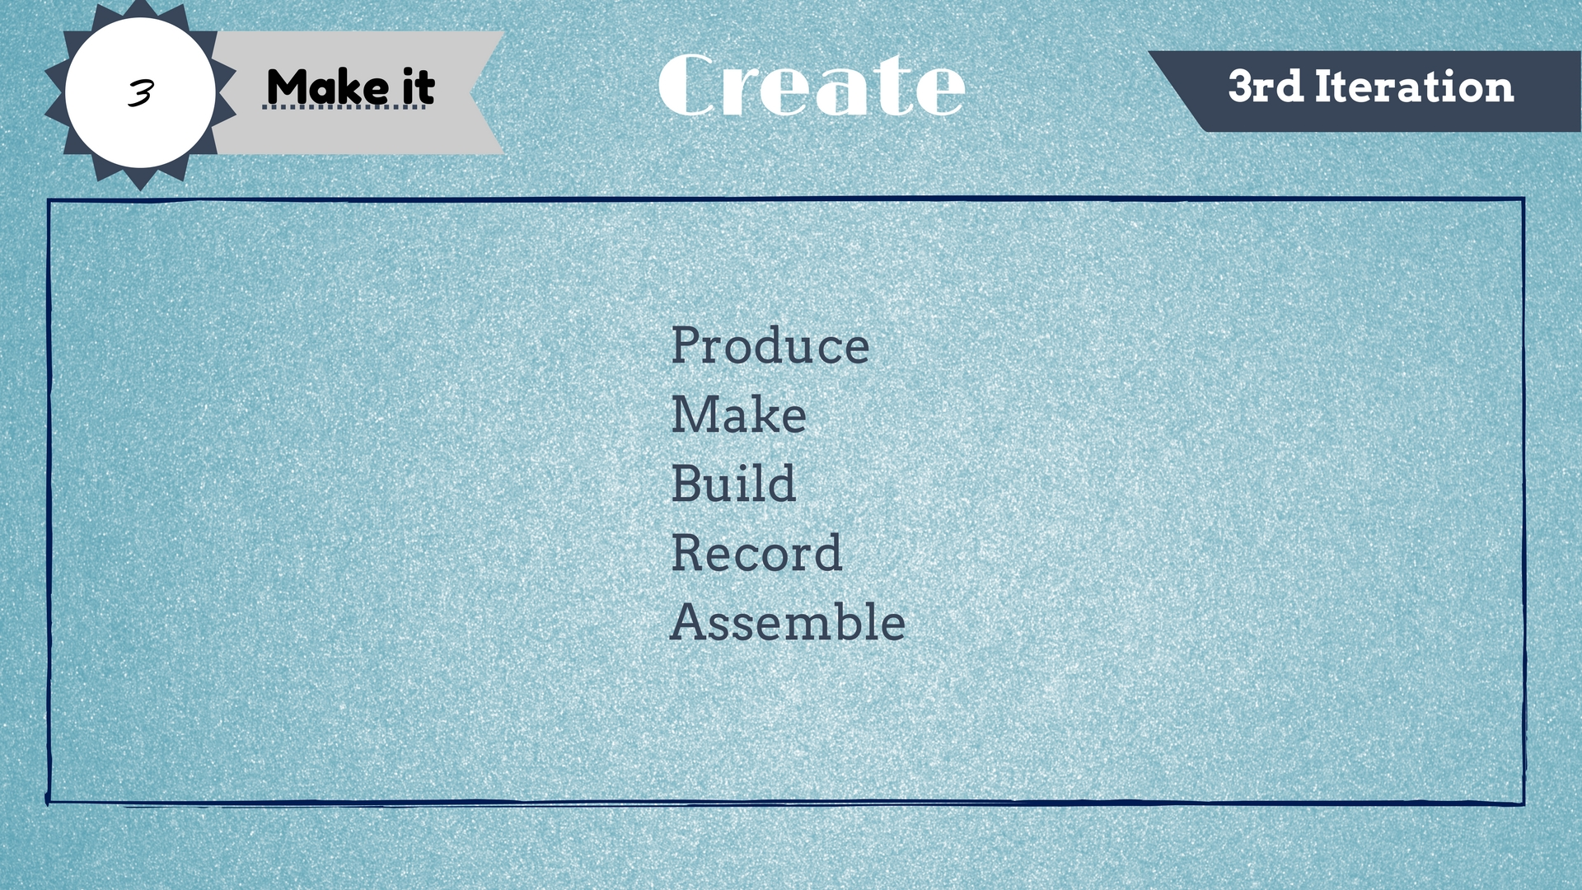

Slide 15
